Slide 1
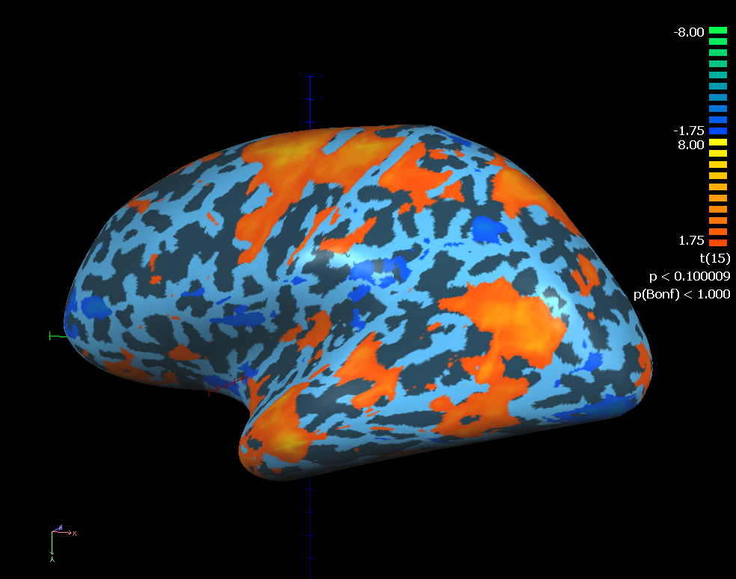
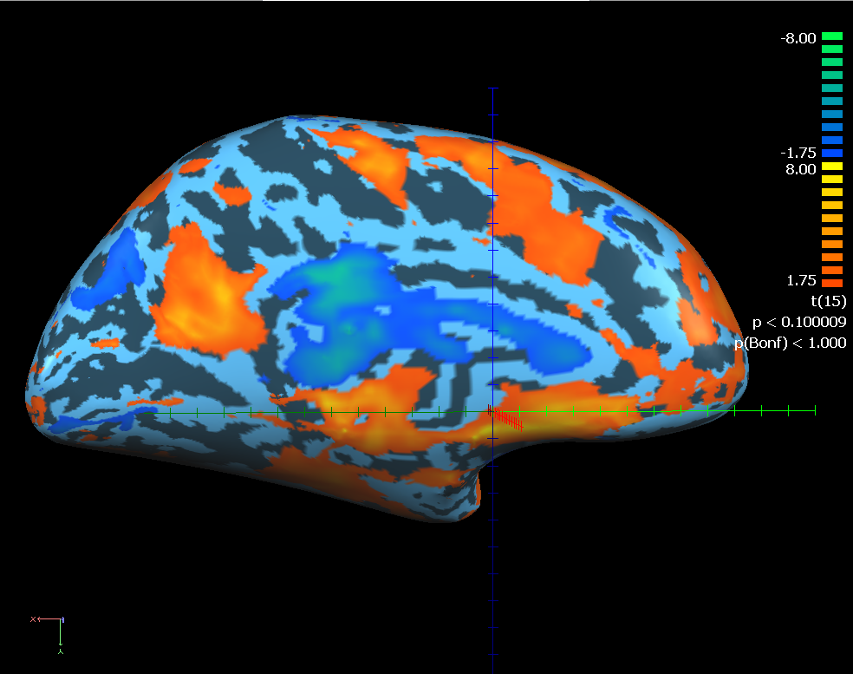
Random effect GLM: WM (delay 1) vs. Fixation (delay 2)---LH

Slide 2
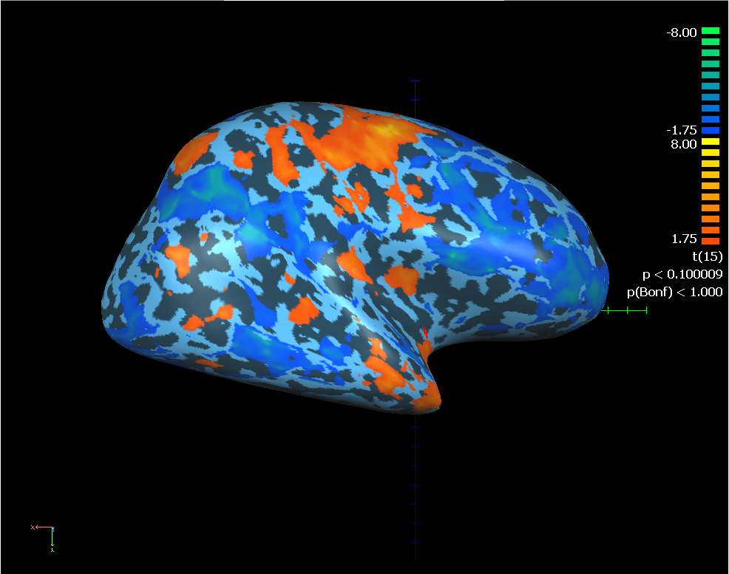
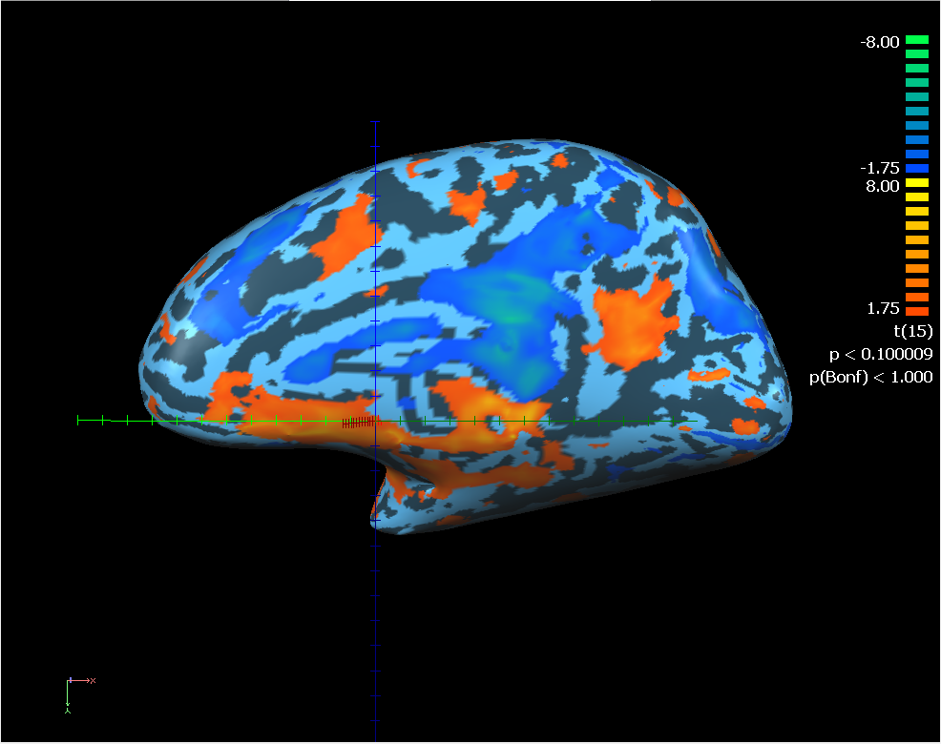
Random effect GLM: WM (delay 1) vs. Fixation (delay 2)---RH

Slide 3
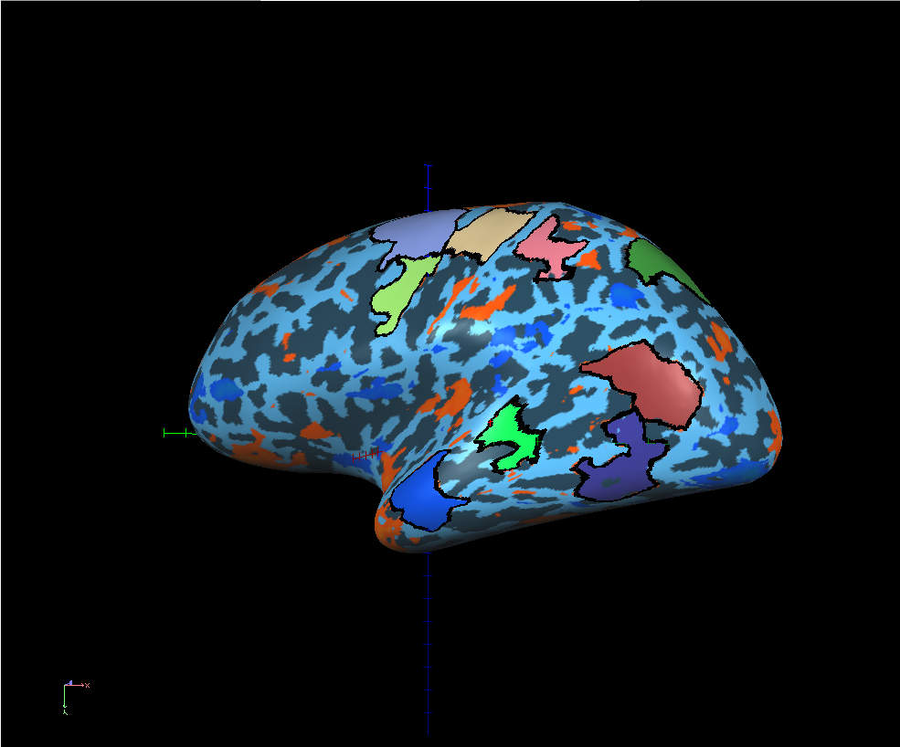
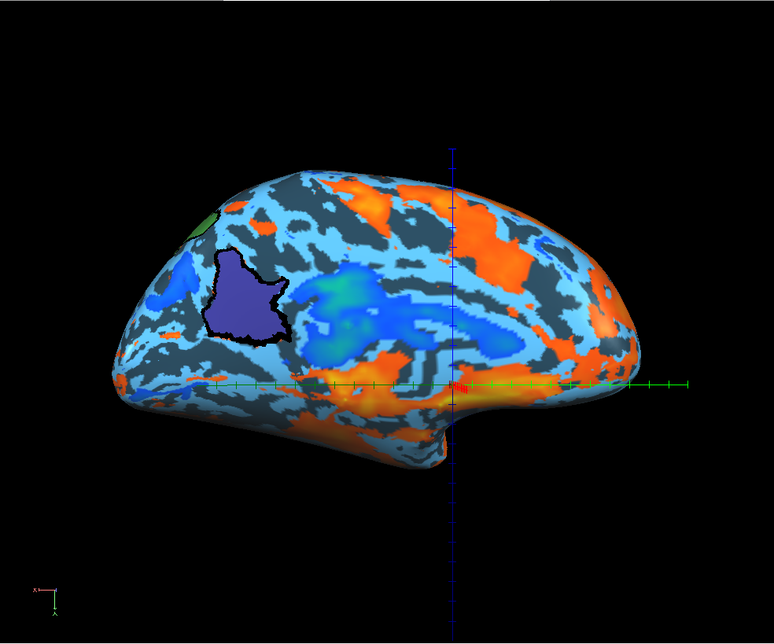
LH ROIs
FEF_LH
M1_LH
sIPS_LH
aIPS_LH
PMv_LH
T1_LH
PCC_LH
T3_LH
T4_LH
T2_LH

Slide 4
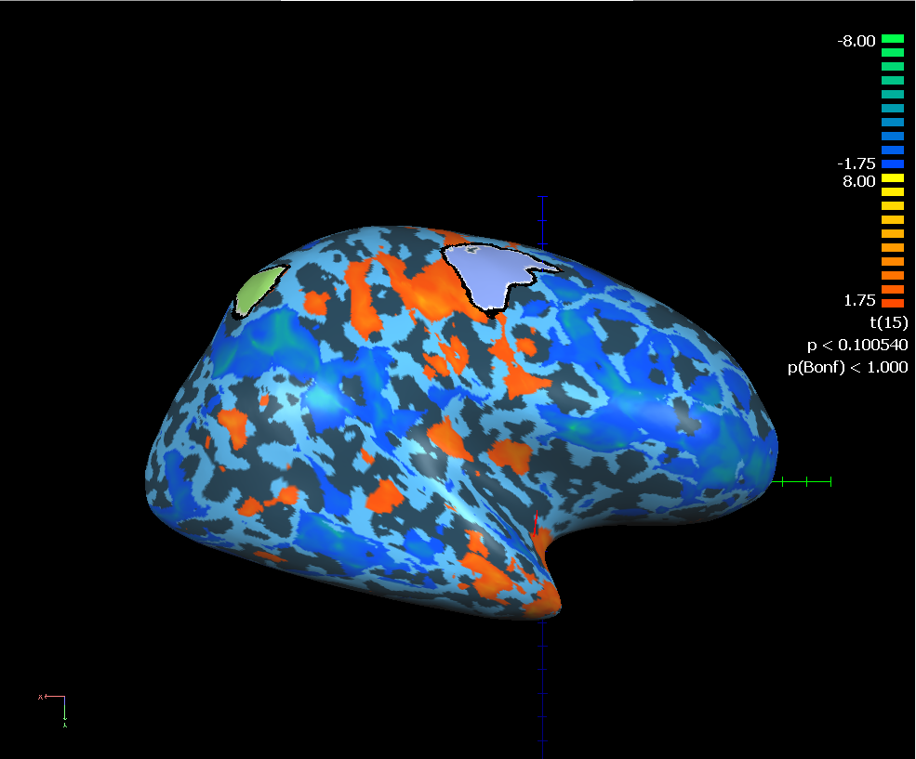
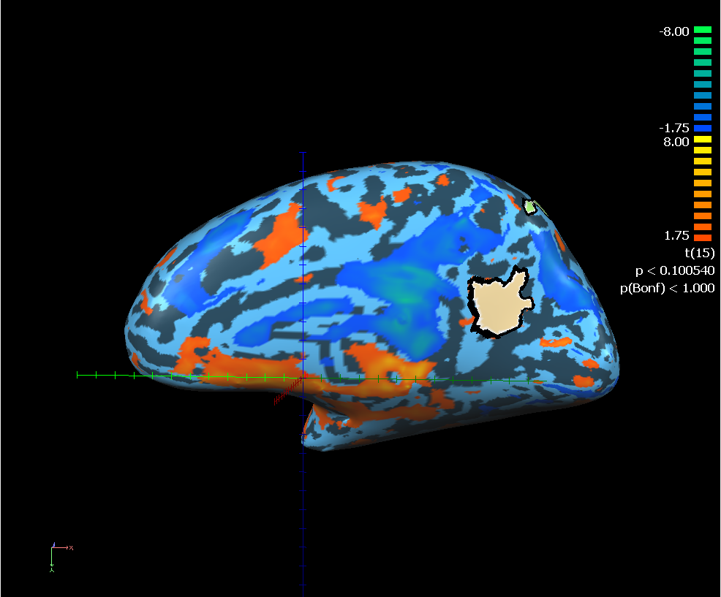
RH ROIs
FEF_RH
sIPS_RH
PCC_RH

Slide 5
PSC---z
Session effect

Slide 6
PSC---z---baseline: trial onset
Session effect

Slide 7
MVPA_75 voxels (Masked with grey matter)
 | Pre-test | Mid-test | Post-test
FEF_LH | 53.51563 | 50.19531 | 53.58073
PMv_LH | 50.78125 | 52.60417 | 50.19531
M1_LH | 55.01302 | 51.95313 | 48.24219
aIPS_LH | 51.36719 | 52.60417 | 52.14844
sIPS_LH | 51.23698 | 54.03646 | 52.79948
T1_LH | 49.67448 | 49.73958 | 48.3724
T2_LH | 51.95313 | 49.15365 | 50.65104
T3_LH | 49.54427 | 52.53906 | 51.69271
T4_LH | 48.76302 | 48.82813 | 49.80469
PCC_LH | 50.58594 | 49.80469 | 48.82813
FEF_RH | 52.01823 | 51.6276 | 50.65104
sIPS_RH | 52.47396 | 52.73438 | 51.17188
PCC_RH | 49.86979 | 49.28385 | 47.78646

